Slide 1
Data Shield
Submitted in the partial fulfillment for the award of the degree of
BACHELOR OF ENGINEERING
IN
INFORMATION SECURITY
Submitted By :
SHUBHAM SINGH 19BCS3558
ADITYA SHINDE 19BCS3548
SATYAM KUMAR 19BCS3557
ABDUL MOGHNI 19BCS3556
AJIT KUMAR 19BCS3563
Under the Supervision of:
PROF. GAURAV SRIVASTAVA
Department of AIT-CSE
DISCOVER . LEARN . EMPOWER

Slide 2
Outline
Introduction to Project
Problem Formulation
Objectives of the work
Methodology used
Results and Outputs
Conclusion
Future Scope
References

Slide 3

Introduction to Project
Cyber Crime is a major concern with the tremendous growth of digital data, as with this emerging threat there is a high risk of data to be stolen. Protecting the important and personal data at individual end is must.
If a system gets hijacked by attacker and able to gain access of your data and expose your work to malicious sites with negative intended it may create a huge problem and to nullify this cybercrime we propose this idea – “Data Shield”.

Slide 4
This project intends to solve these threats and protect user data. It will encrypt all the data and store the data in encrypted format, when the data is required back it will decrypt it in its original form.
In case even if the attacker gets the access to user’s data it will be in encrypted format and the attacker won't be able to use it. This project basically targets on the security of data of its users and thus protects it from the malicious attack and breach.

Slide 5
Here a key is used encrypt the user data and then store it, when needed by the user the data can be further decrypted by using the same key.

Slide 6

Problem Formulation
Tons of data generation per day leading major threat to its security.
Cyber crime has adverse effects and greatly affects directly or indirectly all of us.
The access to unencrypted data lead to such cyber crime.

Slide 7

Here the cryptography plays an roles in securing the data.
The approach used to encounter this problem is to encrypt files on system with the password and decrypt with the same password when required.
The encrypted files won’t be of no use even if it reaches wrong hands.

Slide 8

Objectives
To explore and implement an encryption and decryption program to use with the aim of providing the user with a basic knowledge of the fundamental techniques of encryption and decryption.
To provide the user with authentication, integrity, confidentiality and non-repudiation of the data. To provide the user with an enhanced security of their data.
To provide the user with a way to easily and conveniently protect the data or information

Slide 9

Methodology Used
The methodology used in this work produce a simple and secure solution for image, text encryption and decryption. This technique is easy to implement and understand. The following steps give a brief idea about the methodology involved in this entire work.
ALGORITHM FOR FILE ENCRYPTION
1) Input image to be encrypted
2) Divide the image into 8x8 blocks.
3) Perform DCT on all this blocks and save the results in
another array.

Slide 10
4) Encrypt the selected coefficient by XORing with a random
bit generated by random bit generator
5) Reconstruct the image.
ALGORITHM FOR FILE DECRYPTION
1) Input encrypted image.
2) Encrypt the selected coefficient by XORing with a random
bit generated by random bit generator.
3) Divide the image into 8x8 blocks.
4) Perform IDCT on all this blocks and save the results in
another array.
5) Decrypted Image is obtained.

Slide 11
ALGORITHM FOR AES ENCRYPTION AND DECRYPTION
For text encryption and decryption we used AES Algorithm It’s Based on a design principle known as a substitution- permutation network.
It has a fixed block size of 128 bits, and a key size of 128, 192, or 256 bits.
The key size used for an AES cipher specifies the number of repetitions of transformation rounds that convert the input, called the plaintext, into the final output, called the ciphertext.

Slide 12
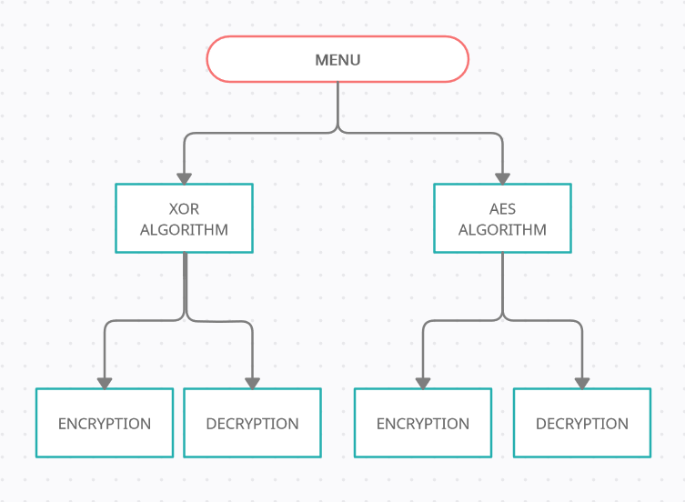
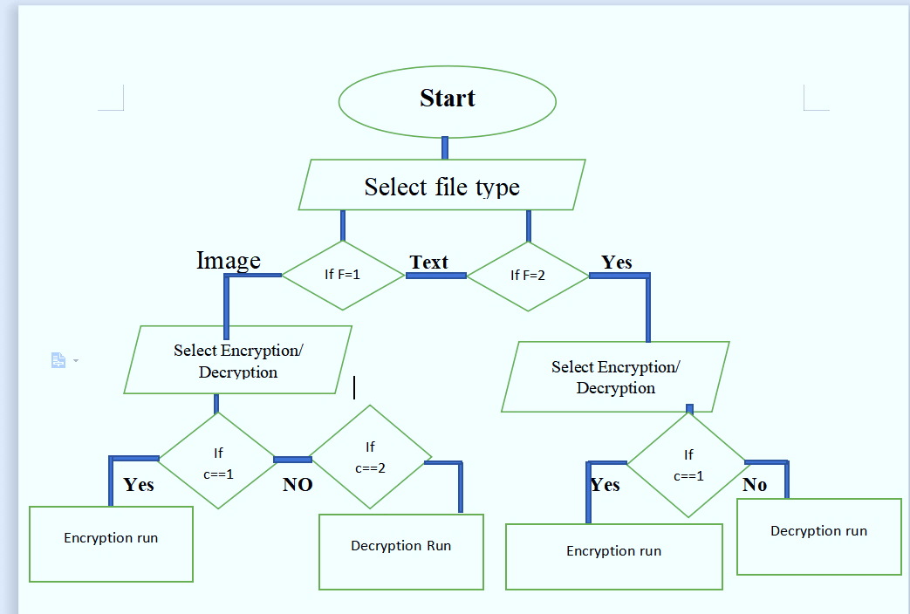
DMF
Flow Chart

Slide 13

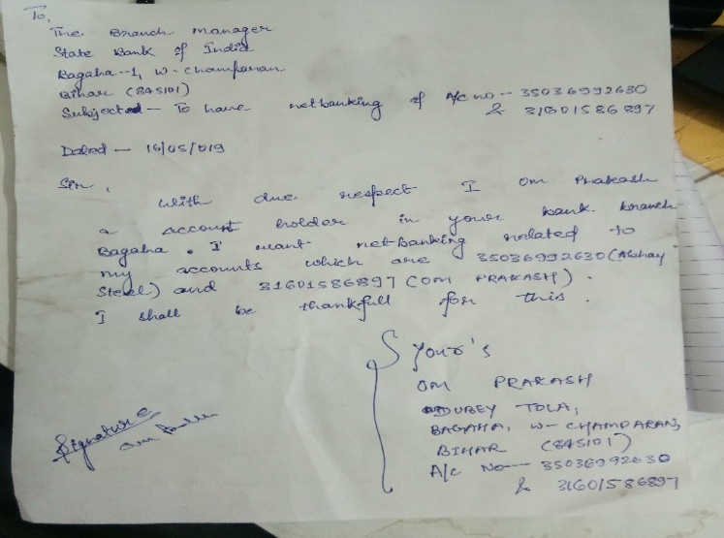
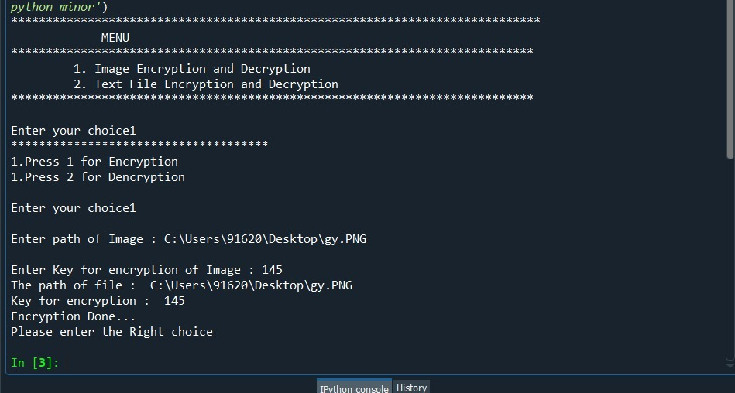
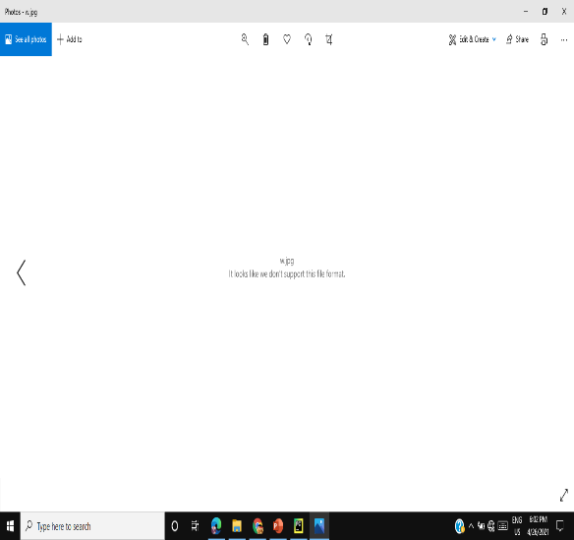
Results and Outputs
The proposed system is implemented successfully and the following results are obtained.
Experiment No (1):- In which we encrypt & decrypt the image on CLI
mode .
Original Image Applying Encryption Encrypted Image

Slide 14
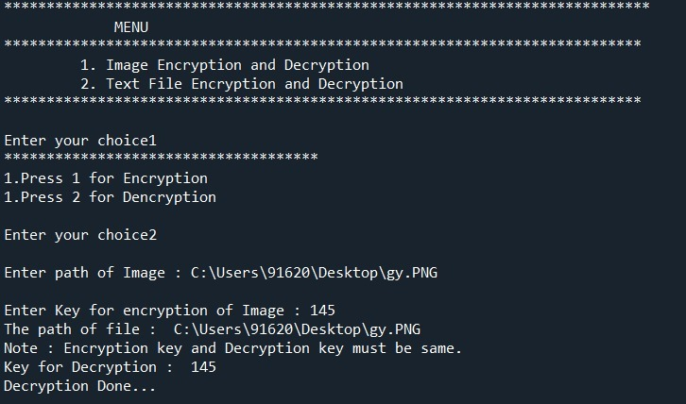

Applying decryption Decrypted Image
Experiment No (2):- In which we encrypt & decrypt the image on GUI mode.

Slide 15
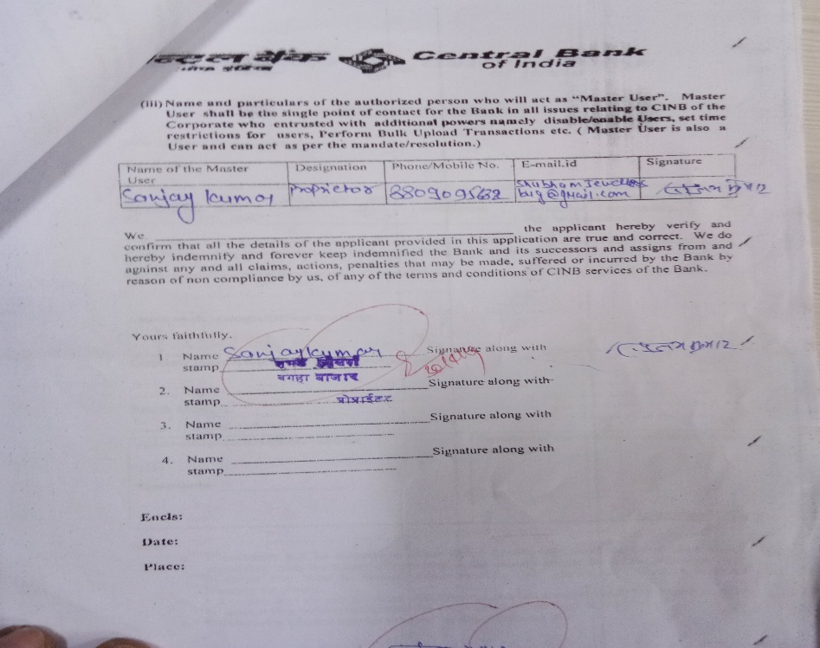
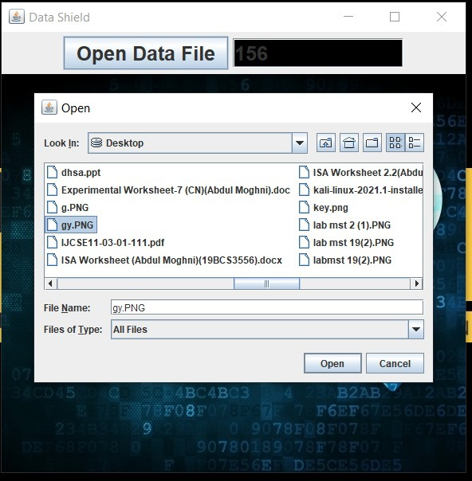
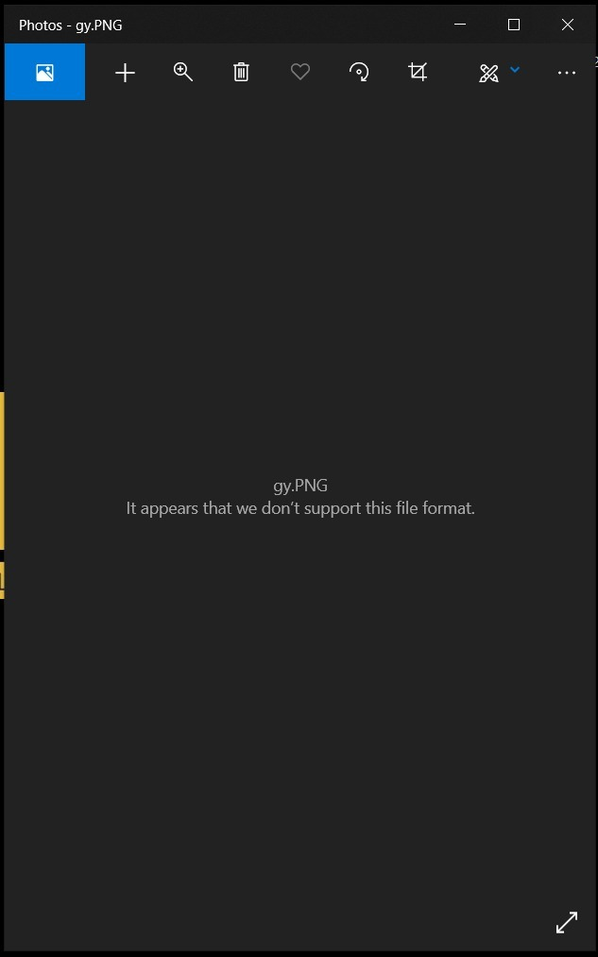
Original Image Applying Encryption Encrypted Image

Slide 16

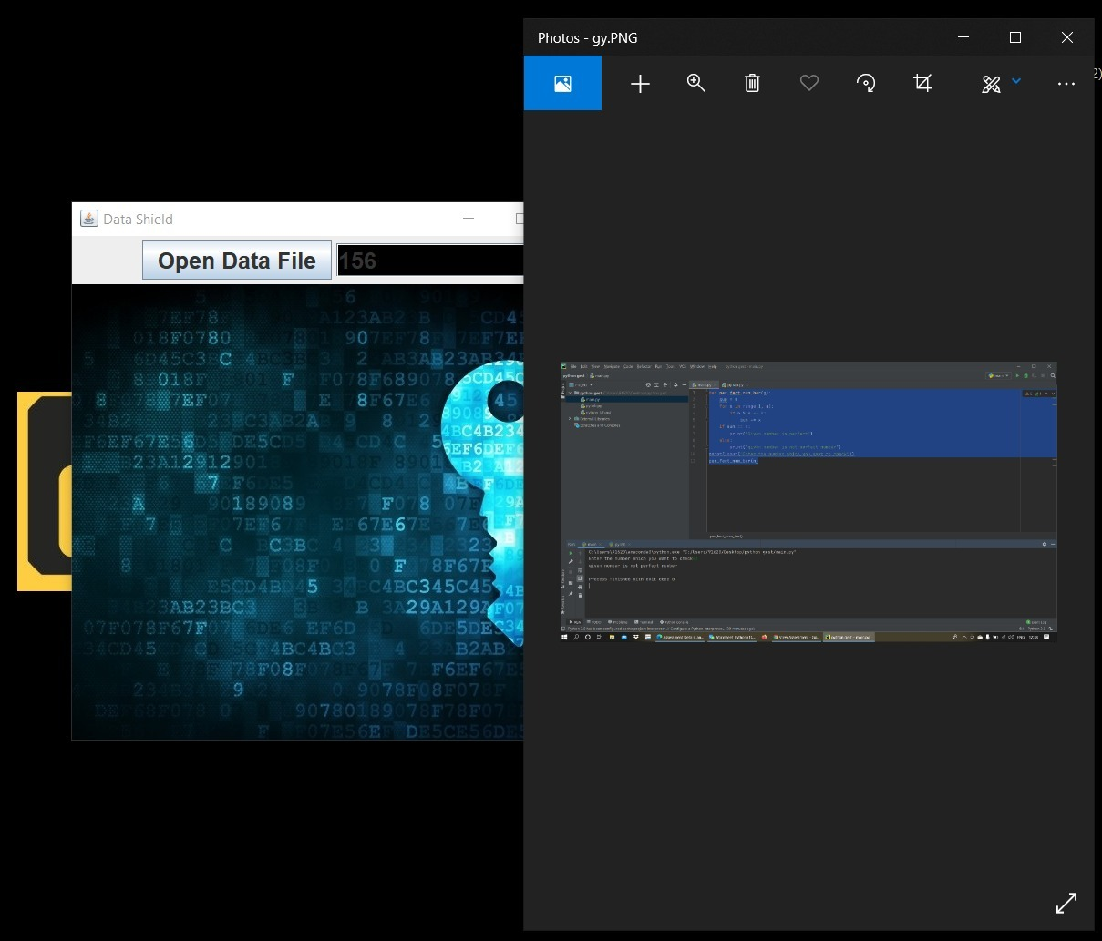
Applying decryption Decrypted Image

Slide 17
Conclusion
In this work a technique for faster image, text encryption is proposed.
Experiments have demonstrated that the algorithm can fully encrypt the 2D and 3D images. The original 2D and 3D images can also be completely reconstructed without any distortion.
The presented algorithms are easy to implement in hardware because they operate at the binary levels.

Slide 18
Future Scope
Encryption of folders and Drive/Disk in later version.
Restricting user to access or commit changes to encrypted files.
Auto code execution from GUI and Responsive.
Complete GUI based Aes encryption Desktop Application File (exe).

Slide 19
References
Ayushi “A Symmetric Key Cryptographic Algorithm” International Journal of Computer Applications (IJCA) ISSN : 0975 – 8887) Vol. 1 – No. 15 , February 2010. Available: http://www.ijcaonline.org/journal/number15/pxc387502.pdf
Research on a Normal File Encryption and Decryption https://ieeexplore.ieee.org/document/5778802
Document of pycryptAes module https://pypi.org/project/pyAesCrypt/
Research paper for AES algorithm. https://www.researchgate.net/publication/317615794_Advanced_Encryption_Standard_AES_Algorithm_to_Encrypt_and_Decrypt_Data
Research paper for XOR algorithm https://www.researchgate.net/publication/50247254_Encryption_using_XOR_based_Extended_Key_for_Information_Security_-_A_Novel_Approach
William “Cryptography and Network Security Principles and Practice”, Fifth Edition, Pearson Education, Prentice Hall, 2011.

